Slide 1
Sociological Frameworks
Notes:
-exceptions…. exception stories
-exceptions are performed by active agents
-living values
-expressing skills of living
-in face of challenges
-have histories
-are witnessed

Slide 2
Durkheim and Structural Functionalism
Functionalist approach.
Robert Merton and Talcott Parsons came up with this approach. Influential approach which guided studies on social stratification in India till the 1970s..
Social differences, and inequalities are present in order to maintain the system. Stratification is seen as essential, performing a certain role. Various participants and groups consent to this stratification, because they are so organically connected to it. In some ways, the functionalist approach rationalises social stratification.

Slide 3
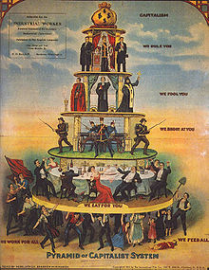
Conflict theories: Marxist approach
Conflict theories see an exercise of power in the process and functioning of social stratification.
Marxist approach.
Dialectical. Social stratification is not treated as a given. Caste for instance was originally not determined by birth. It became a system that was based on birth. So Marxists try to understand how and why stratification happened. CLASSES as largely economic in nature.

Slide 4
Conflict theories: Weberian approach
This uses class, status and power to explain social stratification.
Weber argued that status distinctions could appear independently of economic class.
Weber saw ‘power’ as an important factor. This power was related to membership in an organisation – and was not necessarily related to economic status or social status.
WEALTH, POWER and PRESTIGE – together determine the “Weberian Class”.
M.N. Srinivas and the ‘Dominant Caste’ analysis of Indian society. This dominant caste analysis has been successfully used by sociologists to explain political trends in India.

Slide 5


